Slide 1
Legal Aid System
Application Engineering and Development
Team: Namespace
Mounika Nalla
NUID : 1063351
Keerthana Thoddoon Ravi
NUID: 1085057

Slide 2
PROBLEM STATEMENT
India is a developing country and yet we see major issues concerning women’s safety, child labor, divorce, depression, mental health, family disputes. These are not widely spoken about
Fearing for the society, people ignore these issues unaware of whom to speak with
These lead to increase in more social and mental issues

Slide 3
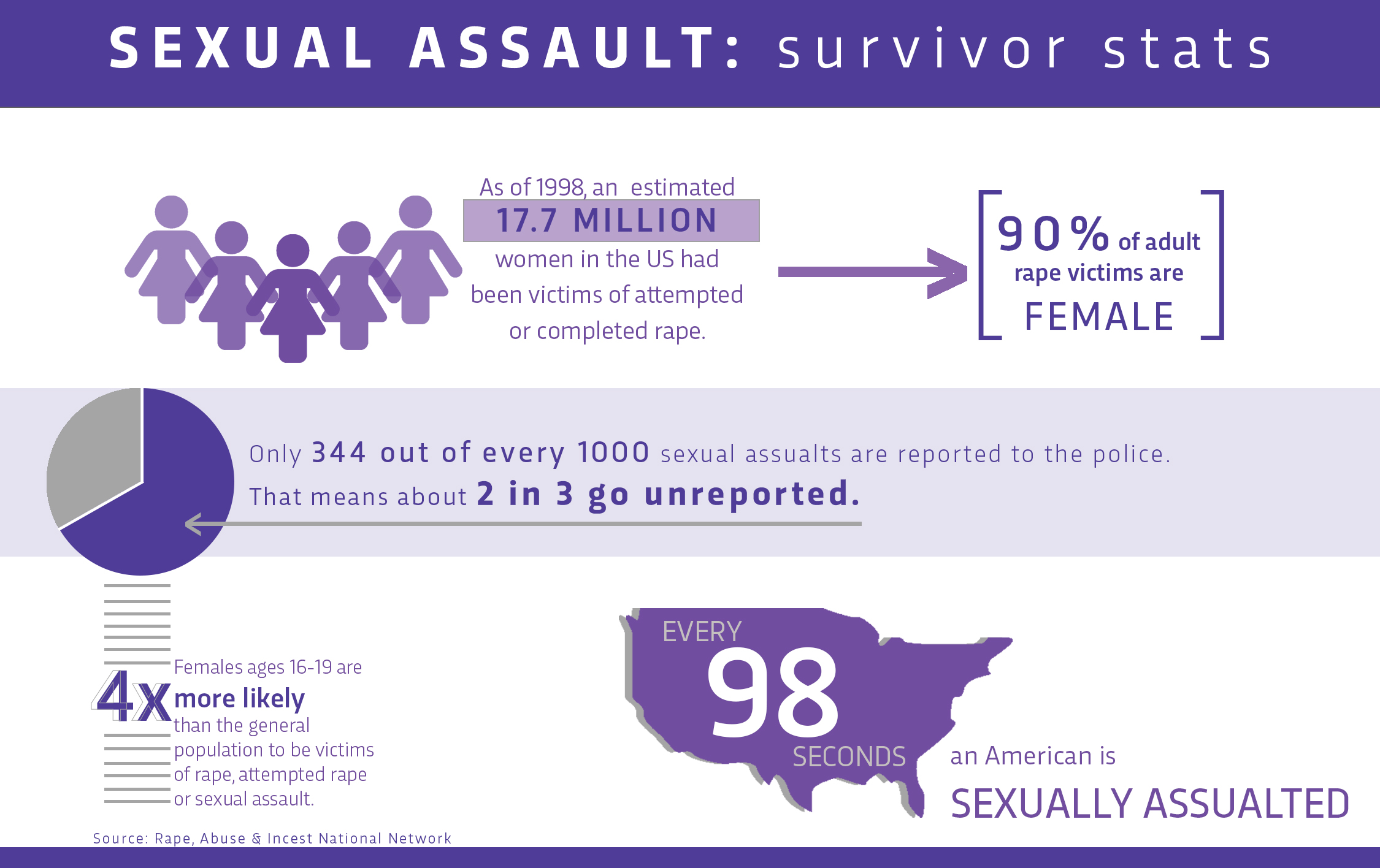
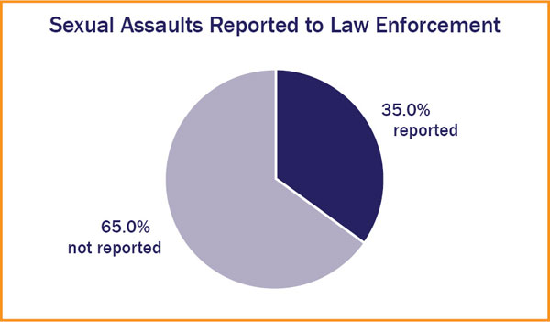
SEXUAL ASSAULTS
YOU ARE NOT A VICTIM FOR SHARING YOUR STORY.
YOU ARE A SURVIVOR WAKING UP THE WORLD WITH THE TRUTH

Slide 4
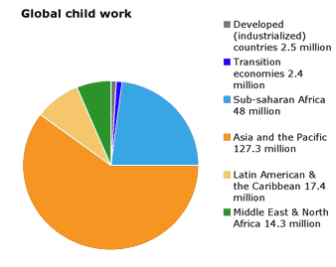
Do you know who to approach for child labor?

Slide 5

MENTAL DISORDER
HAVING A MENTAL DISORDER
DOESN’T YOU ARE CRAZY

Slide 6
SOLUTION
A common portal for people which lets them register their complaint
A guide to who to reach out to in any situation that people are ashamed of or feared to speak about
A lawyer, physiologist to who has experience and not known to many people
A portal that lets people know that they are not alone

Slide 7
Primary Approach
User logs in a complaint
User sees there are other people with the same issues
User sees there are lawyers available for each specific problem
The complaint is viewed by an assistant
Assistant examines the issue
Assistant schedules an appointment with the lawyer
Lawyer views the complain, decides if a meeting is required
Lawyer responds to the user

Slide 8
Use Case
Primary Use cases
User should be able to log in a grievance
User should be made aware that there are people to help them
Lawyer should be able to respond to the user

Slide 9
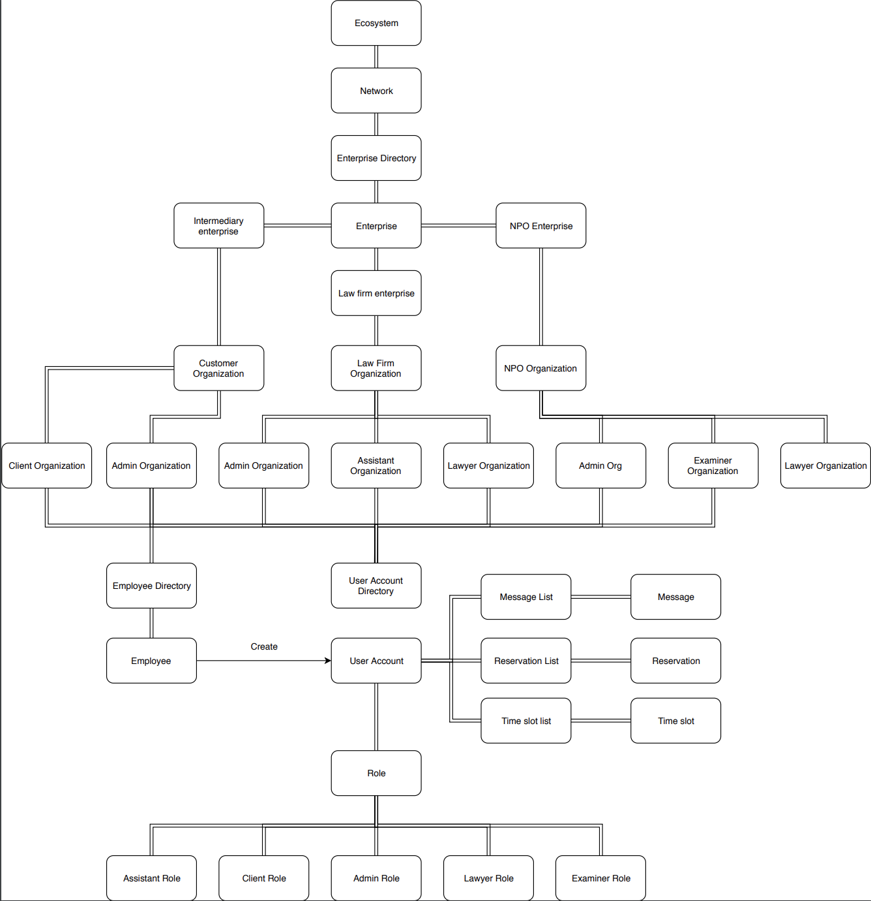
DESIGN

Slide 10
WORK FLOW
System Admin
Admin
Assistant
Examiner
Lawyer
Client

Slide 11
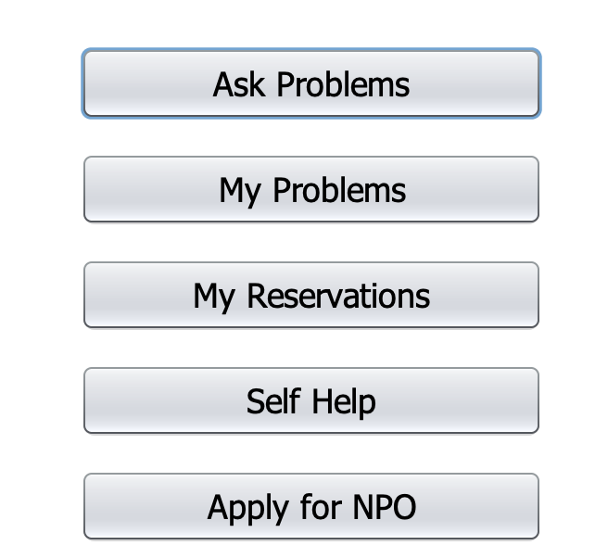
CLIENT PROFILE

Slide 12
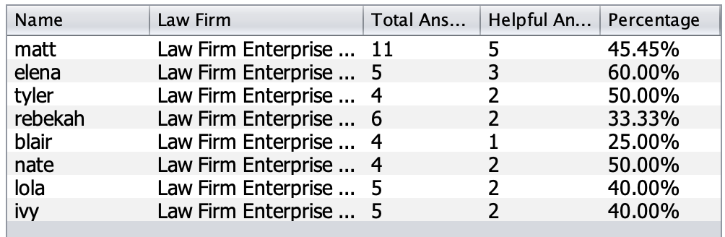
CLIENT PROFILE

Slide 13
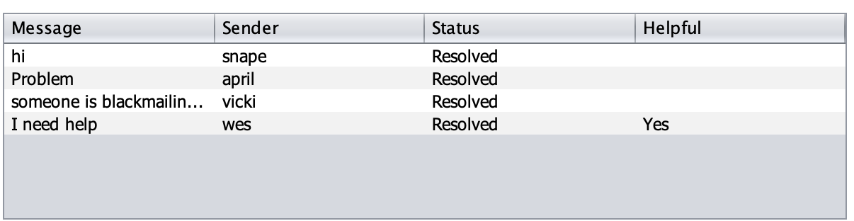
LAWYER PROFILE

Slide 14
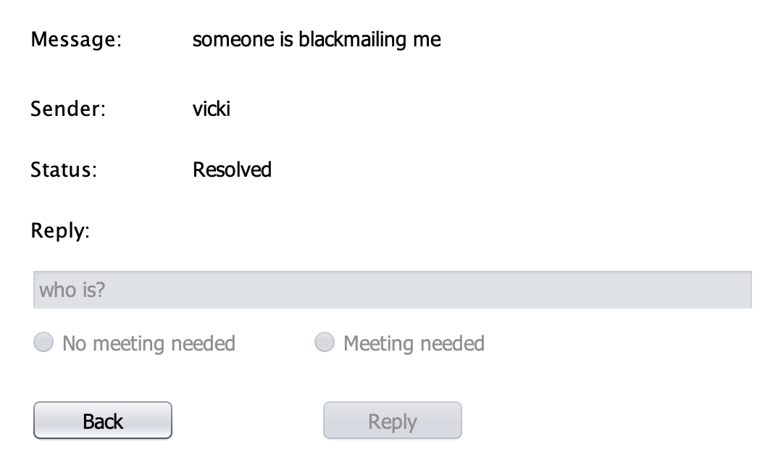
LAWYER PROFILE

Slide 15
Thank You

